Slide 1
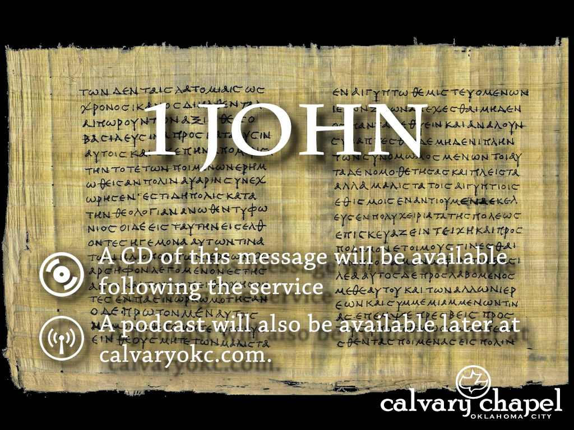
3:19-4:06

Slide 2
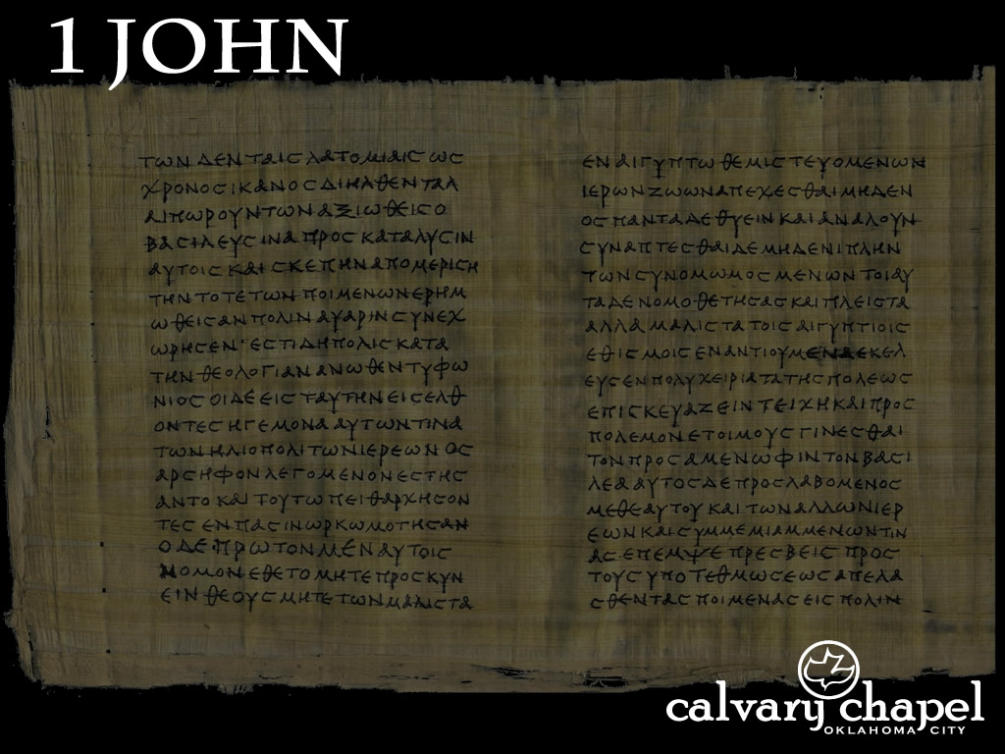
3:19-4:06
Rom. 12:9 ~ Let love be without hypocrisy. Abhor what is evil. Cling to what is good.
Word = tongue
Deed = truth

Slide 3
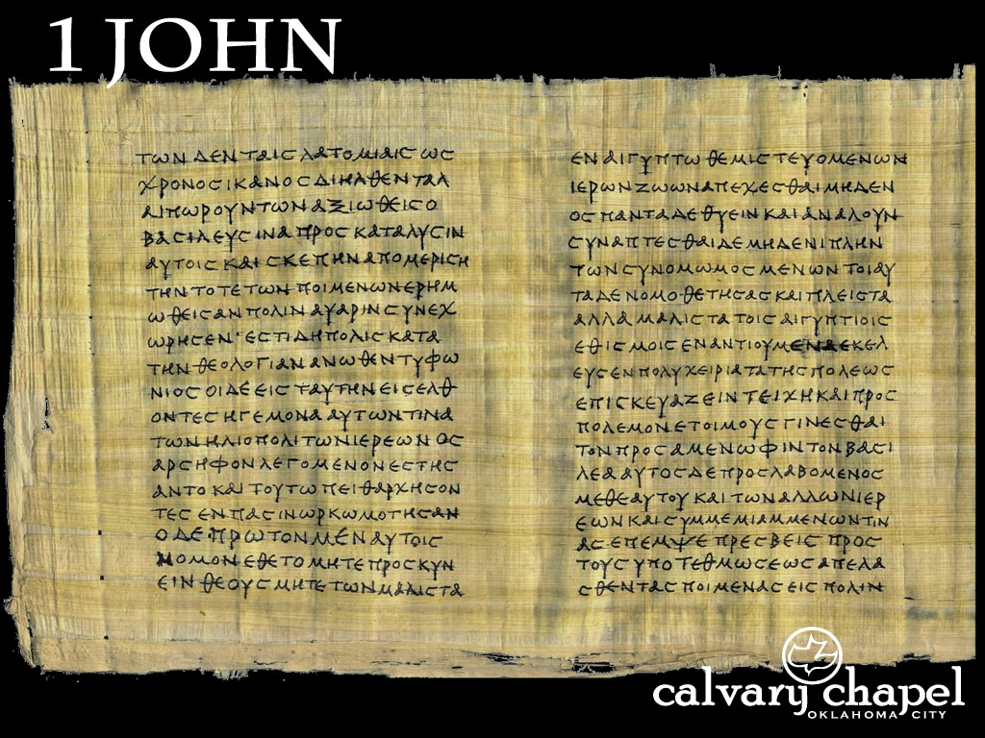
3:19-4:06

Slide 4
3:19-4:06
Rom. 8:33 ~ Who is he who condemns? It is Christ who died, and furthermore is also risen, who is even at the right hand of God, who also makes intercession for us.
Not katakrinō ~ to judge against
But rather kataginōskō ~ to know against
Ps. 103:14 ~ For He knows our frame; He remembers that we are dust.

Slide 5
3:19-4:06

Slide 6
3:19-4:06
John 6:28-29 ~ ²⁸ Then they said to Him, “What shall we do, that we may work the works of God?”
²⁹ Jesus answered and said to them, “This is the work of God, that you believe in Him whom He sent.”

Slide 7
3:19-4:06

Slide 8
3:19-4:06
Eph. 1:13-14 ~ ¹³ In Him you also trusted, after you heard the word of truth, the gospel of your salvation; in whom also, having believed, you were sealed with the Holy Spirit of promise, ¹⁴ who is the guarantee of our inheritance until the redemption of the purchased possession, to the praise of His glory.

Slide 9
3:19-4:06

Slide 10
3:19-4:06
Heb. 11:1-2 ~ ¹ God, who at various times and in various ways spoke in time past to the fathers by the prophets, ² has in these last days spoken to us by His Son, whom He has appointed heir of all things, through whom also He made the worlds;

Slide 11
3:19-4:06

Slide 12
3:19-4:06
Confess ~ homologeō – to say the same thing
1 Cor. 12:3 ~ Therefore I make known to you that no one speaking by the Spirit of God calls Jesus accursed, and no one can say that Jesus is Lord except by the Holy Spirit.

Slide 13
3:19-4:06

Slide 14
3:19-4:06
Matt. 8:29 ~ And suddenly they cried out, saying, “What have we to do with You, Jesus, You Son of God? Have You come here to torment us before the time?”
Mark 1:24 ~ “Let us alone! What have we to do with You, Jesus of Nazareth? Did You come to destroy us? I know who You are — the Holy One of God!”
Merrihew Standard Version ~ This is how you can tell whether a belief is from God or not: Does it claim that Jesus is God incarnate? And any belief that Jesus is not God incarnate is not of God … in fact, it’s of the Antichrist.

Slide 15
3:19-4:06

Slide 16
3:19-4:06
Will the real Jesus please stand up?
LDS ~ spirit brother of Lucifer
Lorenzo Snow ~ “As man is, God once was; as God is, man may be.”
Watchtower ~ Michael the Archangel
Word of Faith ~ lost His deity
New Age ~ found the Christ-consciousness
Emergent church ~ shape-shifting Jesus

Slide 17
3:19-4:06

Slide 18
3:19-4:06
Outer Court
Body
Ark
Table of Showbread
Golden Altar
Menorah
Holy of Holies
Bronze Laver
Bronze Altar
Spirit
Mind
Holy Place

Slide 19
3:19-4:06

Slide 20
3:19-4:06
Error ~ literally deception (NLT)
NIV ~ falsehood

Slide 21
3:19-4:06

